Slide 1
Calorie Chronicle
Abi O’Neal, Kami Nelson, Deana Carter, Keilor Brown, Peggy Waite
Notes:
Calorie Chronicle is transitioning from being a static information-oriented website to providing a simple, personalized, interactive wellness tool. Calorie Chronicle currently receives more than 8,000 unique visits per month. On average, 72% of their visitors are returning. As the following will outline, these trends combined with the ease-of-use of our web-based application are likely to translate into low overhead and sustainability.

Slide 2
Proposal to Develop a Database-Driven, Personalized Wellness Resource
Calorie Chronicle seeks to provide registered users with a web-based, easy-to-use, and simple caloric intake and caloric burn personal tracker. In order to fulfill the expressed needs of the company, a database will be required. The first table (or series thereof), whose data will be used to complete caloric intake calculations, will consist of food items.
Columns (fields) would contain calorie values for potential measurements (1/2 cup, 1 tablespoon, etc.). For items that could not be measured by a specific quantity, the value will be null. Each row of data, which corresponds to a single item, would contain a unique identifier (1, 2, 3, 4, etc.). The unique identifier will help to ensure that query-based data retrievals are correct. A similar table will contain the amount of calories burned for different activities at different intervals.

Slide 3
Proposal to Develop a Database-Driven, Personalized Wellness Resource
In order to manage users, another table will contain a unique user id, username, encrypted password, and similar. Two additional tables will store event-based user data, one for positive values (intake) and one for negative values (calories spent). Each event will be inserted using the user’s unique id and calorie value.
The inclusion of unique IDs for each event and item will allow the programmer to effectively and efficiently join various tables to provide accurate and comprehensive user data. Additionally, users and administrators will be able to modify individual records through a simple interface. As an example, if user Bob Bobberton added 1 Hour of 8mph Treadmill to his profile in error, he could simply edit or delete that specific event. If an administrator had a need to update any of the food or exercise items, they could likewise interact with a simple user interface.

Slide 4
Strategy and Analysis
Technology and health have becoming increasingly interlinked. Diet websites, “smart” scales, and mobile device applications have all been developed to help users help themselves lose weight, track health metrics, and more.
While simple tools exist to aid users in tracking the calories that they eat, and expend, many solutions fail to provide users with meaningful, practical, and simple suggestions for a better self and better health. A suggestion to enjoy a handful of whole raw almonds, rather than a tablespoon of peanut butter, could help a user to learn new habits and satiating practices.

Slide 5
Strategy and Analysis - Continued
In order to generate revenue, Calorie Counter will provide users with closely related, healthy, and personalized suggestions from certified and vetted advertisers. In the whole raw almonds example, a list of potential sources of the treat will be shown to the user (Bergin Nut Co., Truly Raw, etc.). Additional sources of revenue could be gained by providing an association-based “You may also like…” suggestion based on user contributed brands and foodstuffs. All potential sources of revenue and competitive advantage are predicated on the foundational principle of providing users with quality, personalized, and health-oriented suggestions.
In the status quo, Calorie Chronicle has a static website that offers visitors information on calories in food items and calories burned for various activities. While the information provided is useful, the current website provides no interactivity, personalization, or tracking capabilities.

Slide 6
Analysis of the Current System
Calorie Chronicle currently receives more than 8,000 unique visits per month. On average, 72% of their visitors are returning. These analytics suggest that the company has both popularity and visitor loyalty.
Calorie Chronicle has assumed that this loyalty will directly translate into both a strong initial subscriber base and, within the first three months of launch, a growth in popularity and use.
The demonstrable, long-term, and loyal subscriber analytics thus far will enable the company to successfully sell advertising space for food items, fitness equipment, and other highly relevant items. By providing individualized and relevant ads to users, the company is confident that such advertising will both result in sustained revenue and benefit the health and well being of patrons.

Slide 7
Integration with Other Systems &
Design for Change
The proposed website, consisting of both an administrative and standard user interface, is database-driven. By employing a modular design, the website and supporting databases will be highly scalable. This flexibility will enable the new website to be easily integrated with other tools and expanded over time. In addition to being easily integrated with other systems and tools, change management will benefit from the proposed structure.
New features, such as weight tracking, could easily be added by using the principles established in the initial design. The separation of various data types, in conjunction with the use of unique IDs for each individual record, would ensure that the system could be altered, expanded, or otherwise modified without undermining the integrity or utility of existing data.

Slide 8
Documentation and Communication
The entirety of the system, including both the website front-end and database back-end, would be wire-framed for Company XYZ. The wireframing process will help to demonstrate the flow of information, user experience, and administrative potential without exposing the Company to unnecessarily complex technical details. During the development and design phases, usability testing would be conducted with small groups of volunteers who were representative of the Company’s existing known customer base. Those tests would help to both provide direction for improvement, and offer third-party validation for the interface proposed.
All communications between the firm and the Company would include succinct, digestible, and proven data. Additionally, diagrams, charts, and other visual aids would be employed to help demystify the entirety of the process.

Slide 9
Existing Resources
Calorie Chronicle’s greatest asset is their existing visitor base. The company has been collecting robust demographic data on their customers for years, through both their website and their corresponding social networking presences. These data will be critical in determining the final design, and subsequent success, of the tool.
Calorie Chronicle likewise has a vastly comprehensive dataset of calorie values for various food items, and physical activities, which are demonstrably accurate. As those data are currently presented in a tabular format, they can easily be exported into a CSV and smoothly imported into the proposed database structure.

Slide 10
Flow Chart

Slide 11
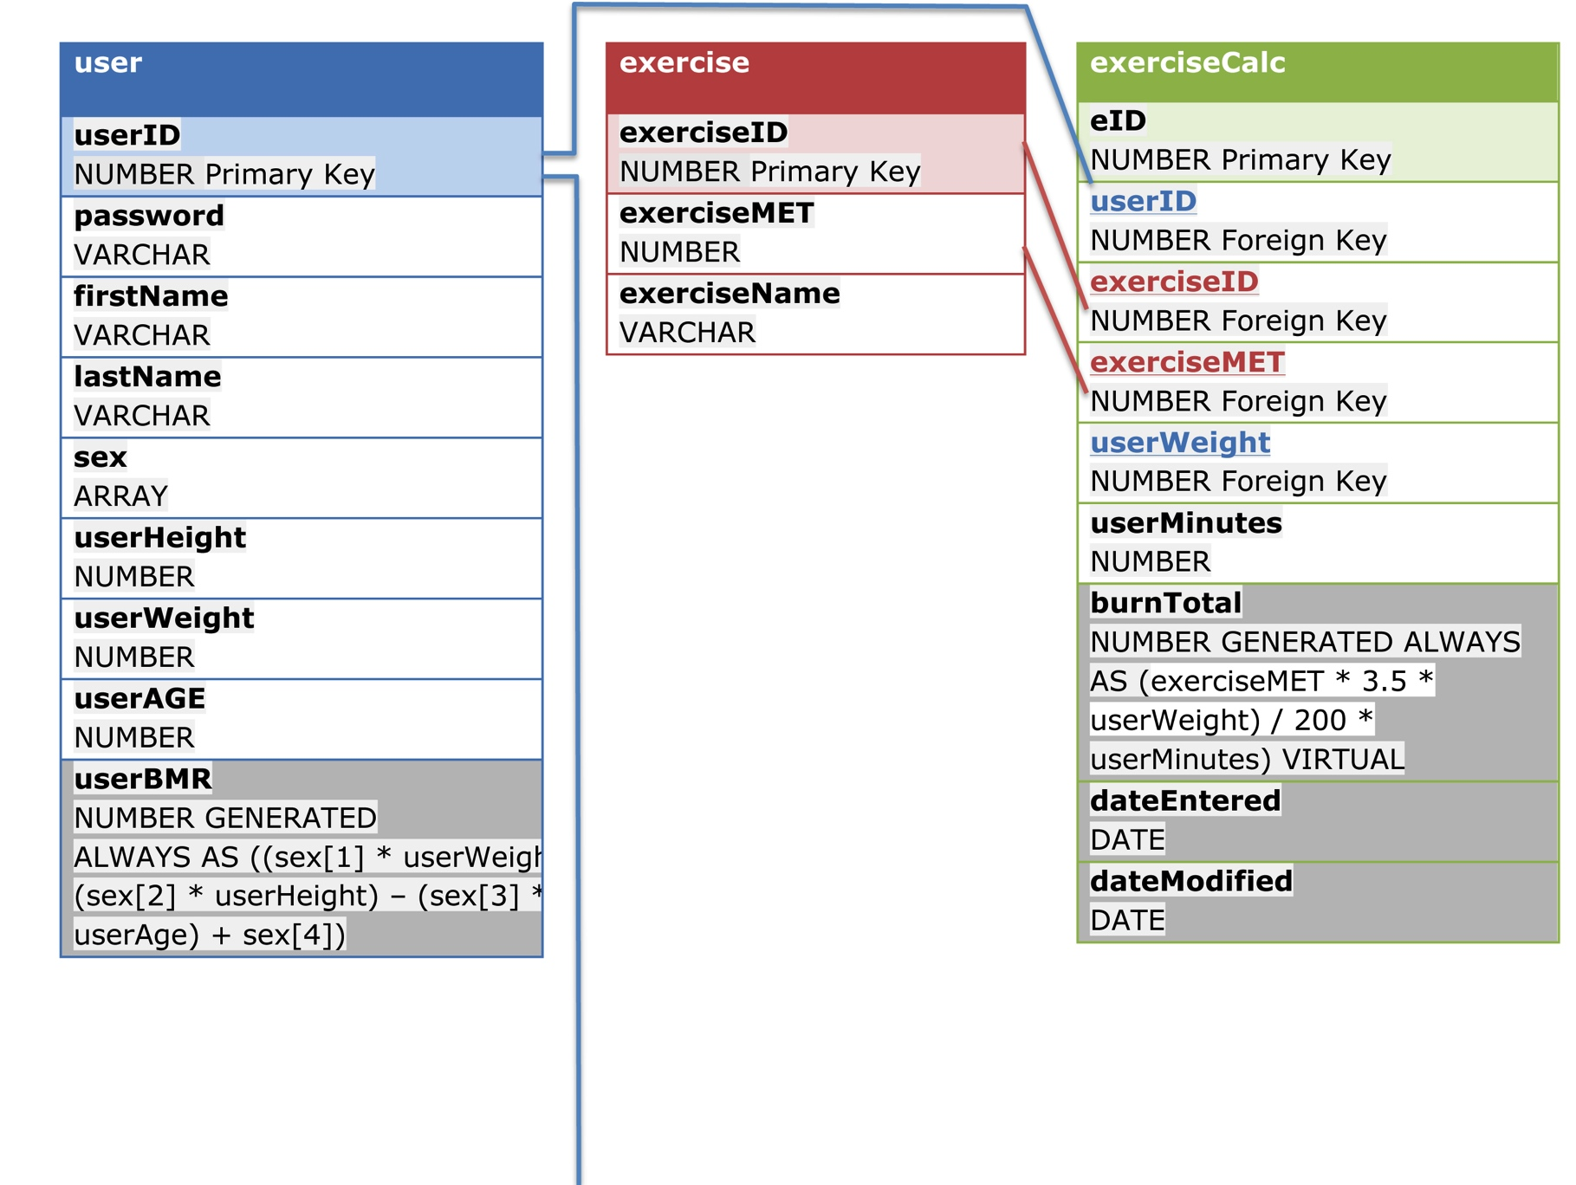
Calorie Chronicle ER Diagram
Notes:
The inclusion of virtual column identification and data types is in excess of our given assignment
guidelines. However, in the interest of full disclosure, we felt obliged to justify why there is an apparent
duplication of certain data elements. Virtual columns will enable us to provide instant, database-driven,
calculations when an INSERT or UPDATE occurs. Employing virtual columns will enable us to avoid client-side
processing and reduce server-side script-based processing. Virtual columns are, unfortunately, limited to intable
data. This restriction has necessitated that we store duplicate data in specific tables. The use of colorcoded
cells and font is intended to show (1) which columns will be automatically generated, (2) which columns
contain primary keys, and (3) which columns contain foreign keys. Grey cells, as an example, indicate data
whose values will be populated on an INSERT or UPDATE. Relations are indicated by the use of font colors. For
instance, userID, when employed as a foreign key in tables other than the users table is colored blue to denote
the relationship to the users table.

Slide 12
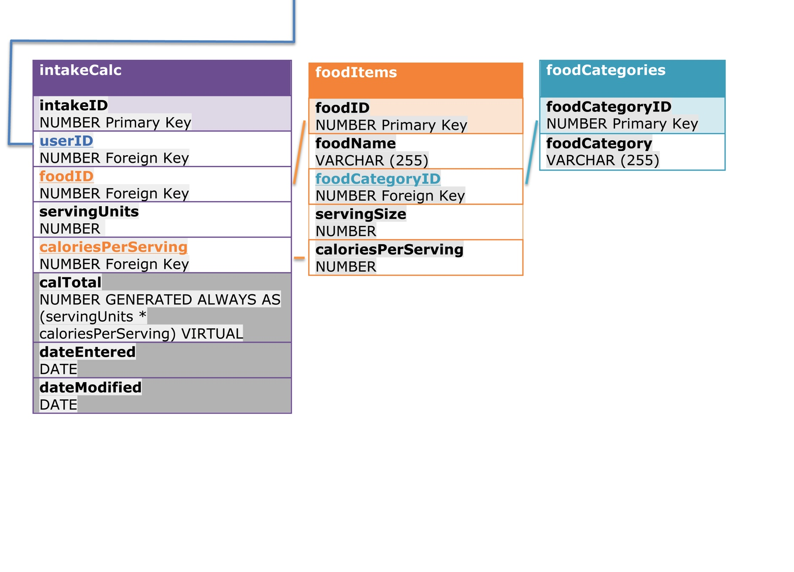
Calorie Chronicle ER Diagram - Continued
Notes:
The inclusion of virtual column identification and data types is in excess of our given assignment
guidelines. However, in the interest of full disclosure, we felt obliged to justify why there is an apparent
duplication of certain data elements. Virtual columns will enable us to provide instant, database-driven,
calculations when an INSERT or UPDATE occurs. Employing virtual columns will enable us to avoid client-side
processing and reduce server-side script-based processing. Virtual columns are, unfortunately, limited to intable
data. This restriction has necessitated that we store duplicate data in specific tables. The use of colorcoded
cells and font is intended to show (1) which columns will be automatically generated, (2) which columns
contain primary keys, and (3) which columns contain foreign keys. Grey cells, as an example, indicate data
whose values will be populated on an INSERT or UPDATE. Relations are indicated by the use of font colors. For
instance, userID, when employed as a foreign key in tables other than the users table is colored blue to denote
the relationship to the users table.

Slide 13

A simple, free, cross-browser tool for users to track what they eat, what they burn, and get suggestions on doing it better.
Notes:
Calorie Chronicle will be taking its current successful website and improving it by offering tracking capabilities and personalization. Doing this will make Calorie Chronicle a database-driven, personalized wellness resource, which will increase current customer loyalty and boost new users and advertisers. It is designed to provide registers users an easy-to-use caloric intake and caloric burning personal tracker via website and mobile app.

Slide 14
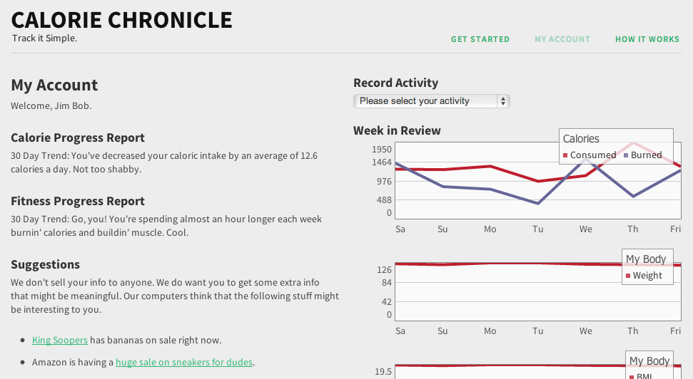
Through a simple web interface, users can view trends, add activity, get tips, and more.
Notes:
The website will allow users to input their daily foods and corresponding calories along with daily exercises which will auto calculate the amount of calories burned for each depending upon the user height, weight and activity intervals. This will allow the user to see daily their intake and burn so they can adjust to reach their health and wellness goals.

Slide 15
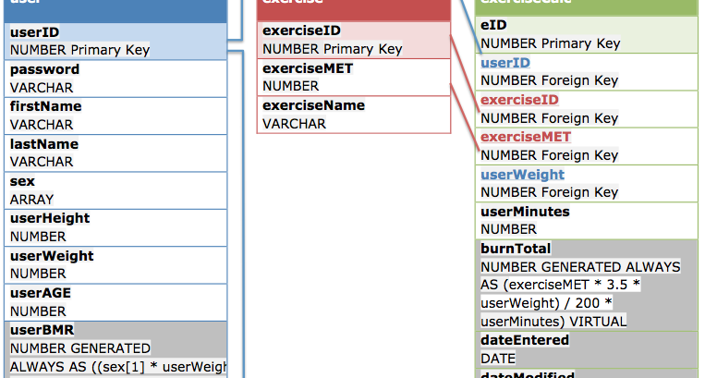
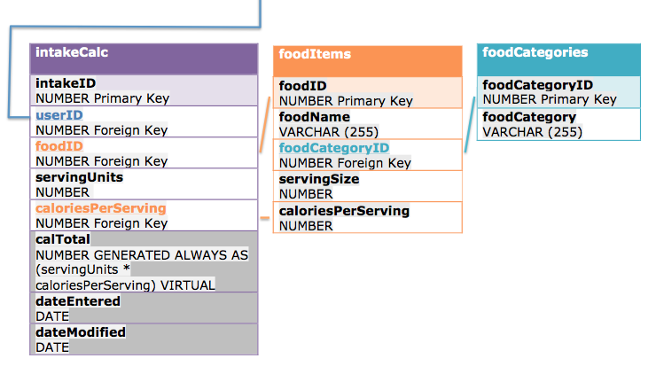
What makes it tick? PHP, MySQL, HTML5, jQuery, and a few other goodies.
Notes:
PHP (Hypertext Preprocessor): PHP is a popular, free, and powerful server-side language. PHP is not vendor dependent; an application written in PHP can easily be hosted in an Apache or IIS environment. PHP is an ideal option for our application to both lower costs and retain a high level of flexibility.
In the context of the Calorie Chronicle, PHP will be used predominately to generate dynamic user content and query the database.
MySQL: Like PHP, MySQL is a free, vendor independent, proven technology. MySQL databases can be run on virtually any server. From an administrative perspective, free tools such as phpMyAdmin provide simple and clean management capabilities.
MySQL will be used to store user data, food details, and exercise details. As demonstrated in our entity diagram, a single database comprised of multiple tables will be capable of supporting our application.
HTML5, CSS3, and jQuery: The front-end for our web-based application will be written in a contemporary version of HTML (hypertext markup language) and CSS (cascading style sheets). The use of a responsive framework, such as the Twitter Bootstrap or Zurb, will enable our design to render properly on any number of devices. The use of tools such as jQuery Modernizer will provide a heightened ability for our application to be backwards compatible with elder and faulty versions of popular browsers. The combined use of HTML5, CSS3, a responsive framework, and a simple design will heighten our ability to maintain a highly usable and accessible site.
The entirety of the system will be hosted with a cloud-based firm that guarantees 100% uptime, maintains backups, and provides unlimited storage space, databases, and bandwidth. While the cloud-based solution is Windows-based, the platform independence of both PHP and MySQL ensure that it will be operable in any environment.

Slide 16
Where’s the money? Sponsored suggestions appear to users based on their recorded activities.
Users get suggestions they might actually like.
Users get suggestions that could help them improve their diets and activity habits.
Sponsors are fully vetted.
Sponsors can pick from various payment models including pay-per-click, monthly exposure thresholds, and so on.
Sponsors and users end up with a solution that works for them.
Notes:
There are plenty of websites, “smart” scales, and mobile device applications to help users lose weight, track health metrics, and more. The major downfall of most of these solutions is that they fail to provide users with meaningful, practical, and simple suggestions to more easily obtain their goals. A suggestion to enjoy a handful of whole raw almonds, rather than a tablespoon of peanut butter, could help a user to learn new habits and satiating practices. By providing our users with these useful and customized tips to their personal eating habits and exercise favorites, we can generate revenue with personalized and tailored advertising. This will allow the users to use the service for free while also providing our advertisers the most return on investment on their advertising dollars through tailored, localized and behavioral marketing campaigns.

Slide 17
What’s the timeline? Around 2 Months.
Phase 1: 2 Weeks
Phase 2: 2-3 Weeks
Phase 3: 2 Weeks
Wire-framing
Preliminary Database Design
Design
Development
Usability testing
Pilot roll-out
Phase 4: 1 Day
Launch!
Bug fixes

Slide 18
What’s it cost? Where’s the ROI?
Expense | Pre-Launch (2 Mos) | 2013 | 2014
Development Cost | 4,600 | 0 | 0
Hosting and Operations | $50/month | $600/yr | $600/yr
Advertising Revenue | 0 | $12.78/user/yr | $19.31/user/yr
Employee Costs | 0 | 142,000 | 190,000
Users 8,000 12,000 16,000 | Profit $-4,700 $-4,700 $-4,700 | Profit $-40,360 $10,760 $61,880 | Profit $-41,520 $35,720 $112,960
Notes:
As demonstrated herein, the relative level of profitability of the Calorie Chronicle is largely dependent on its user base. As an established website, which in the status quo provides basic, flat, data, Calorie Chronicle can expect to begin with a large subscription level. Even a modest estimate of 16,000 users would render Calorie Chronicle profitable within the first full year of launch. With the ease-of-use, zero cost, and utility of the services provided by Calorie Chronicle, the company expects to see sustained exponential growth in use and subsequent profit.

Slide 19
Who is going to make this magic happen?
With an initial budget of $142,000 for personnel costs, the Calorie Chronicle will employ (and need):
  A talented, full-time, PHP developer with a strong background in RDBM (specifically MySQL). Skills with HTML5, CSS3, and jQuery would also be a huge bonus.
  A person who is a whizz with advertising, B2B marketing, and all of the stuff that makes successful advertising relationships work.
Going with an external cloud-based host saves Calorie Chronicle from needing…
  A systems administrator.
  Networking professionals.
  … and probably a lot of other people, too.

